Slide 1
MetaFormer Baselines for Vision
Sea AI Lab | National University of Singapore
arXiv, 2022/10
Notes:
Conference on Neuron Information Processing Systems

Slide 2
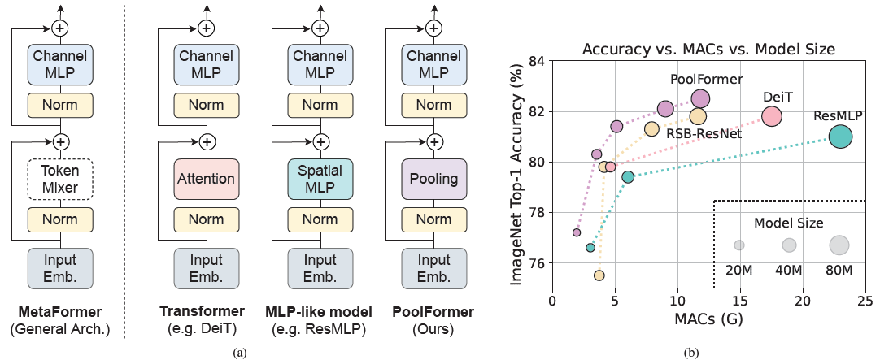
MetaFormer
MetaFormer: a general architecture without specific token mixer, abstracted from Transformer.
PoolFormer: MetaFormer with simple pooling operator as token mixer, outperforms well-tuned Vision Transformer/MLP-like/ResNet baselines.

Slide 3
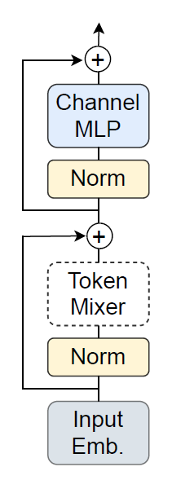
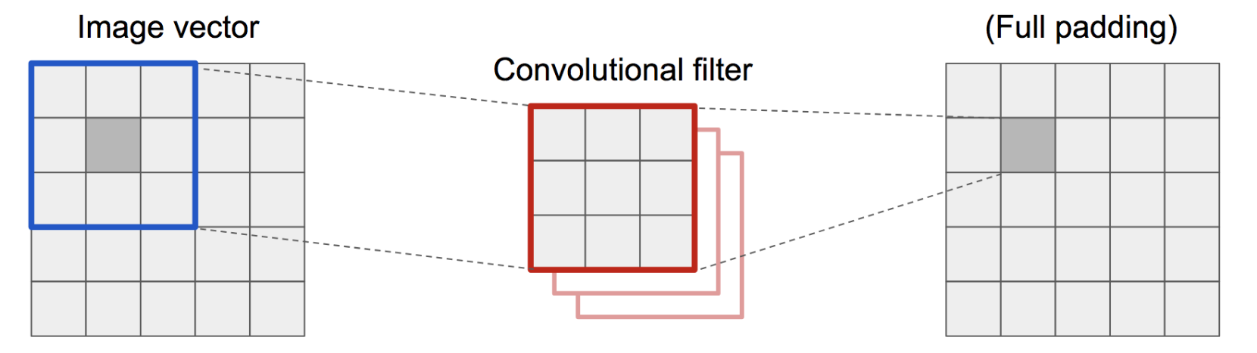
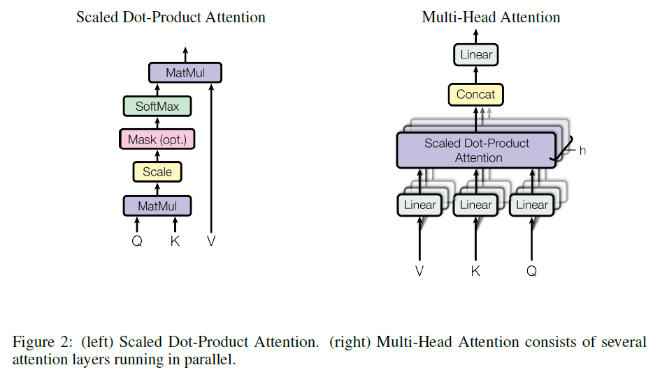
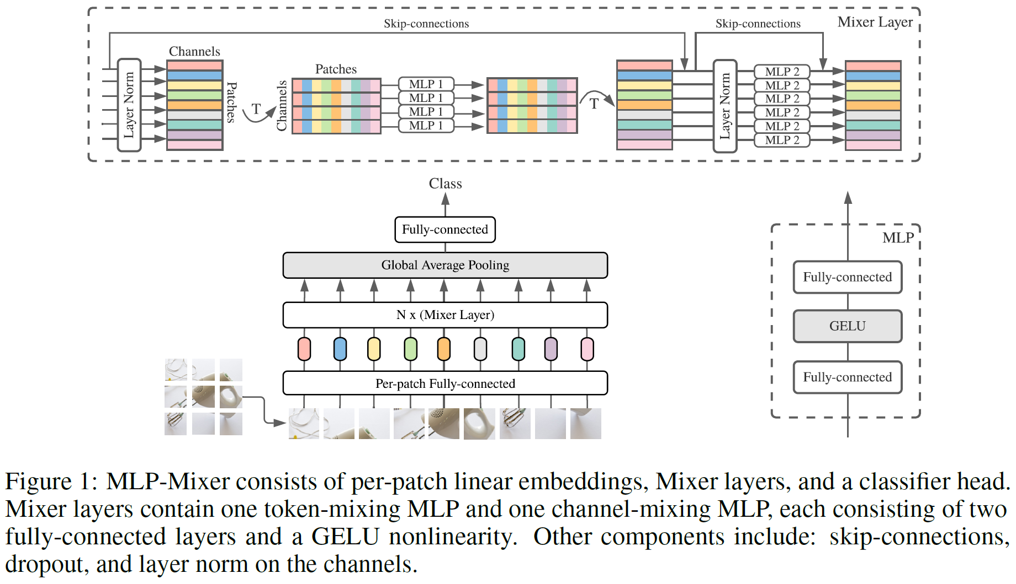
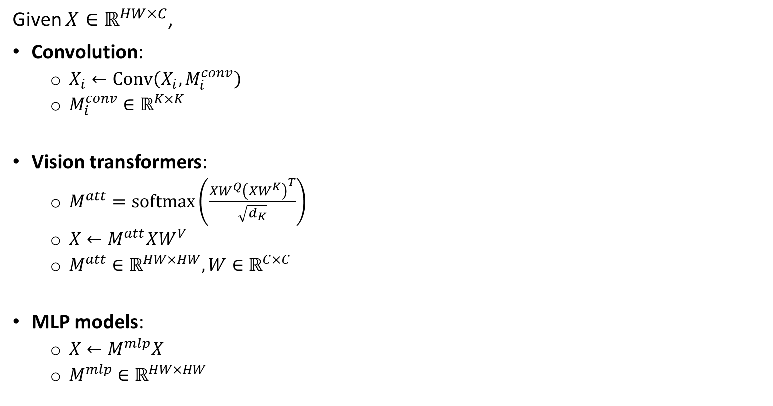
Generalization
Given $X∈ℝ^{HW×C}$,
Convolution:
$X_{i}←Conv\left(X_{i},M_{i}^{conv}\right)$
$M_{i}^{conv}∈ℝ^{K×K}$
Vision transformers:
$M^{att}=softmax\left(\frac{XW^{Q}{\left(XW^{K}\right)}^{T}}{\sqrt{d_{K}}}\right)$
$X←M^{att}XW^{V}$
$M^{att}∈ℝ^{HW×HW},W∈ℝ^{C×C}$
MLP models:
$X←M^{mlp}X$
$M^{mlp}∈ℝ^{HW×HW}$

Slide 4
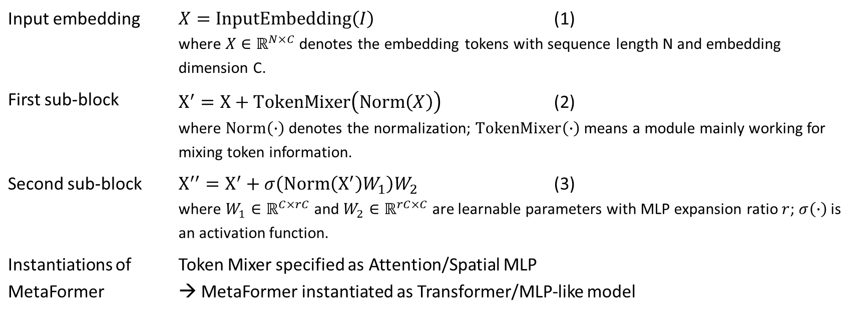
MetaFormer
The input is embedded as a token sequence, then fed into repeated MetaFormer blocks, each of which includes 2 residual subblocks:
Input embedding | $X=InputEmbedding\left(I\right)$ (1) where $X∈ℝ^{N×C}$ denotes the embedding tokens with sequence length N and embedding dimension C.
First sub-block | $X^{′}=X+TokenMixer\left(Norm\left(X\right)\right)$ (2) where $Norm\left(∙\right)$ denotes the normalization; $TokenMixer\left(∙\right)$ means a module mainly working for mixing token information.
Second sub-block | $X^{′′}=X^{′}+σ\left(Norm\left(X^{′}\right)W_{1}\right)W_{2}$ (3) where $W_{1}∈ℝ^{C×rC}$ and $W_{2}∈ℝ^{rC×C}$ are learnable parameters with MLP expansion ratio $r$; $σ\left(∙\right)$ is an activation function.
Instantiations of MetaFormer | Token Mixer specified as Attention/Spatial MLP → MetaFormer instantiated as Transformer/MLP-like model

Slide 5
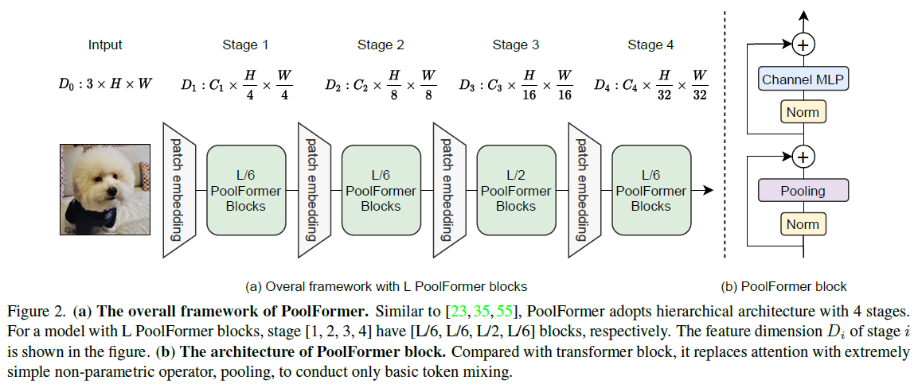
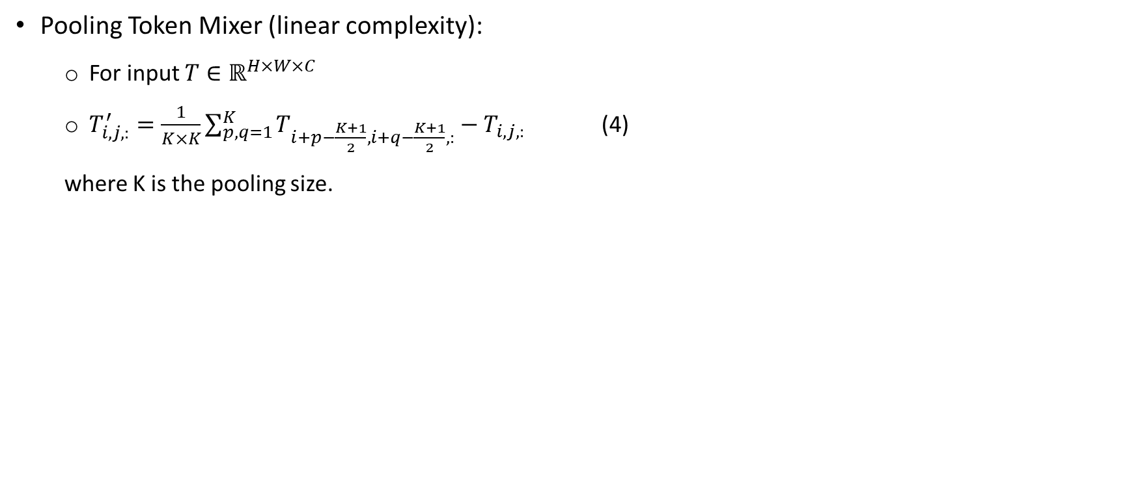
PoolFormer
Pooling Token Mixer (linear complexity):
For input $T∈ℝ^{H×W×C}$
$T_{i,j,:}^{′}=\frac{1}{K×K}\sum_{p,q=1}^{K}{T_{i+p−\frac{K+1}{2},i+q−\frac{K+1}{2},:}}−T_{i,j,:}$ (4)
where K is the pooling size.

Slide 6
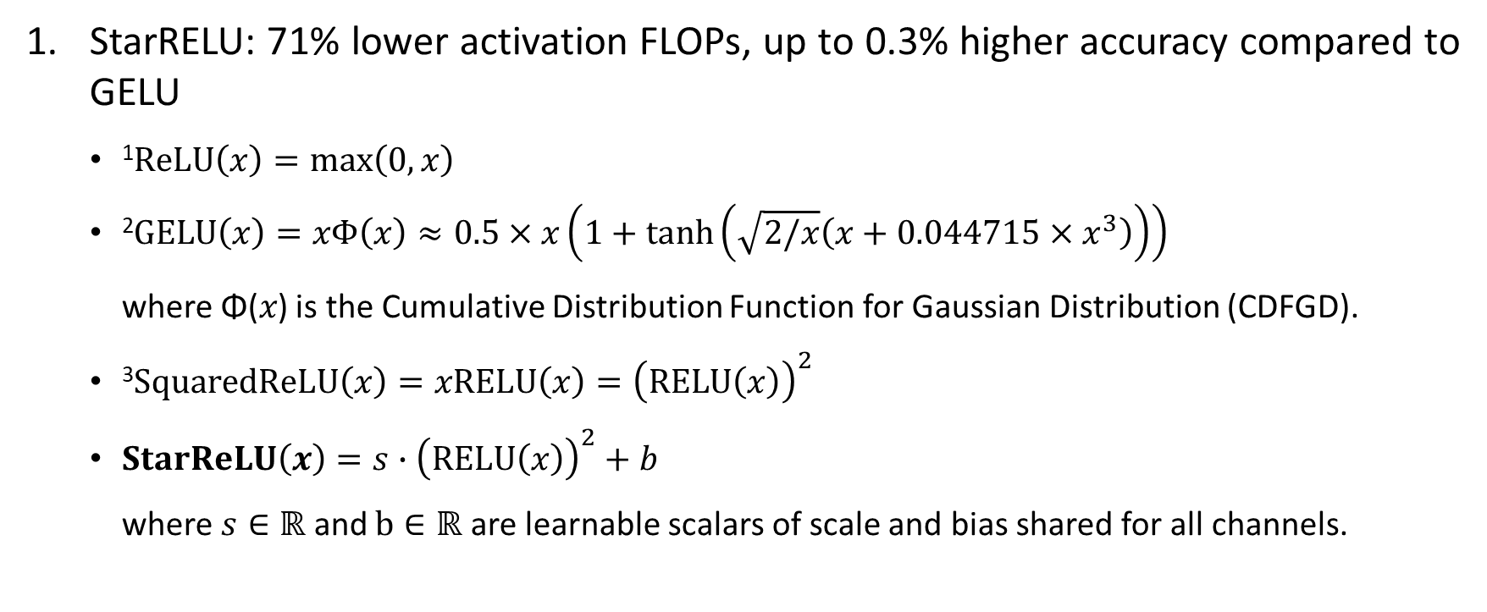
Improved MetaFormer
StarRELU: 71% lower activation FLOPs, up to 0.3% higher accuracy compared to GELU
¹$ReLU\left(x\right)=max\left(0,x\right)$
²$GELU\left(x\right)=xΦ\left(x\right)≈0.5×x\left(1+\tanh\left(\sqrt{2/x}\left(x+0.044715×x^{3}\right)\right)\right)$
where Φ(𝑥) is the Cumulative Distribution Function for Gaussian Distribution (CDFGD).
³$SquaredReLU\left(x\right)=xRELU\left(x\right)={\left(RELU\left(x\right)\right)}^{2}$
$StarReLU\left(x\right)=s∙{\left(RELU\left(x\right)\right)}^{2}+b$
where $s∈ℝ$ and $b∈ℝ$ are learnable scalars of scale and bias shared for all channels.
Notes:
ReLU: 1 FLOP/unit
GELU: 14 FLOPs/unit
Squared RELU: 2 FLOPs/unit
StarRELU: 3-4 FLOPs/unit

Slide 7
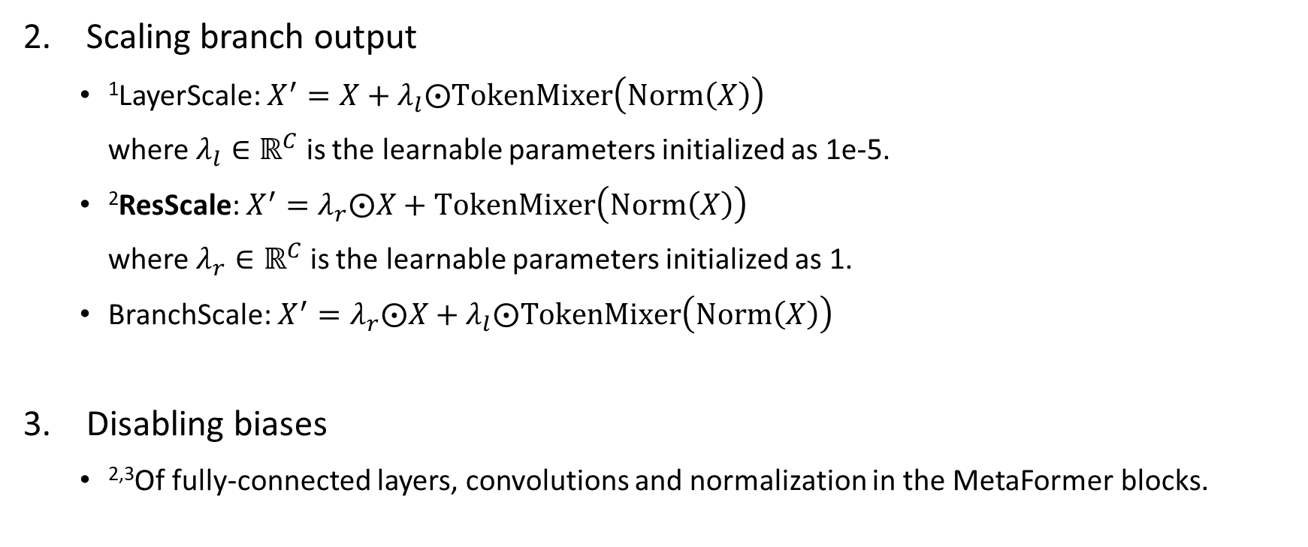
Improved MetaFormer
Scaling branch output
¹LayerScale: $X^{′}=X+λ_{l}⨀TokenMixer\left(Norm\left(X\right)\right)$
where $λ_{l}∈ℝ^{C}$ is the learnable parameters initialized as 1e-5.
²ResScale: $X^{′}=λ_{r}⨀X+TokenMixer\left(Norm\left(X\right)\right)$
where $λ_{r}∈ℝ^{C}$ is the learnable parameters initialized as 1.
BranchScale: $X^{′}=λ_{r}⨀X+λ_{l}⨀TokenMixer\left(Norm\left(X\right)\right)$
Disabling biases
^{2,3}Of fully-connected layers, convolutions and normalization in the MetaFormer blocks.

Slide 8
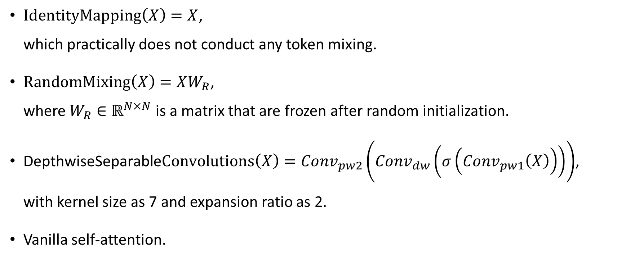
Token Mixers
$IdentityMapping\left(X\right)=X$,
which practically does not conduct any token mixing.
$RandomMixing\left(X\right)=XW_{R}$,
where $W_{R}∈ℝ^{N×N}$ is a matrix that are frozen after random initialization.
$\text{DepthwiseSeparable}Convolutions\left(X\right)={Conv}_{pw2}\left({Conv}_{dw}\left(σ\left({Conv}_{pw1}\left(X\right)\right)\right)\right)$,
with kernel size as 7 and expansion ratio as 2.
Vanilla self-attention.

Slide 9
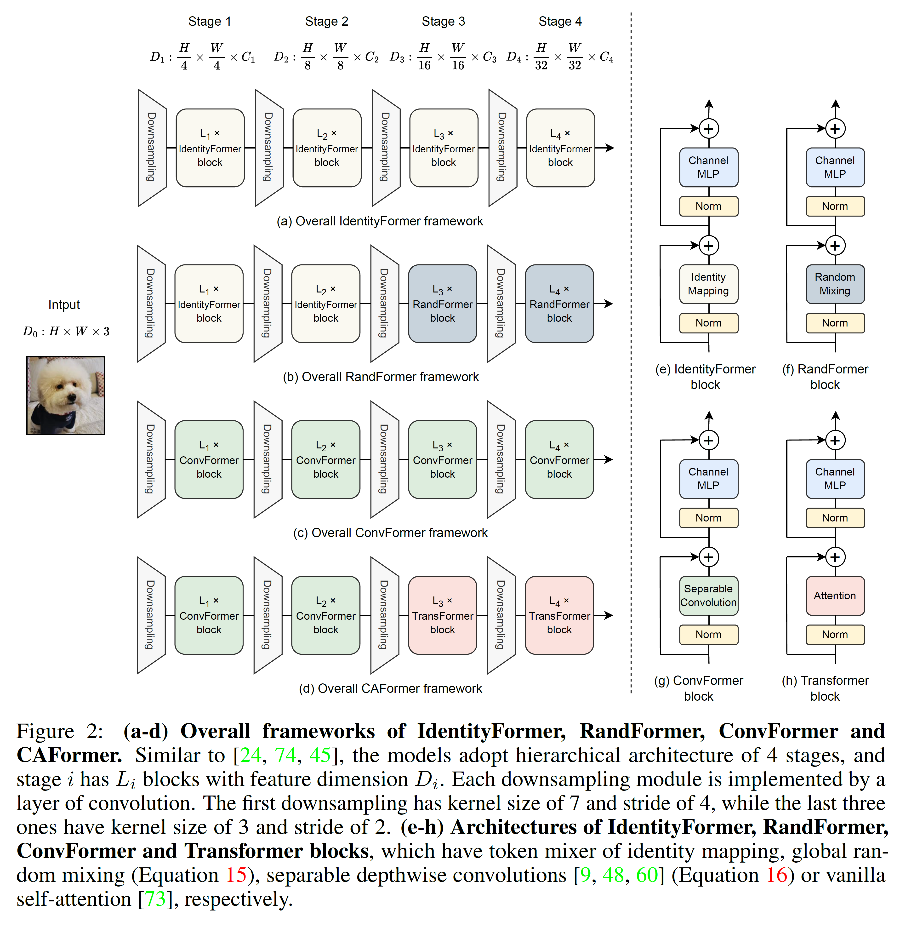
Variations
Notes:
Global random mixing and self-attention token mixers have quadratic complexity w.r.t. the token number.

Slide 10
Variations
Notes:
Global random mixing and self-attention token mixers have quadratic complexity w.r.t. the token number.

Slide 11
Variations
Notes:
Global random mixing and self-attention token mixers have quadratic complexity w.r.t. the token number.

Slide 12
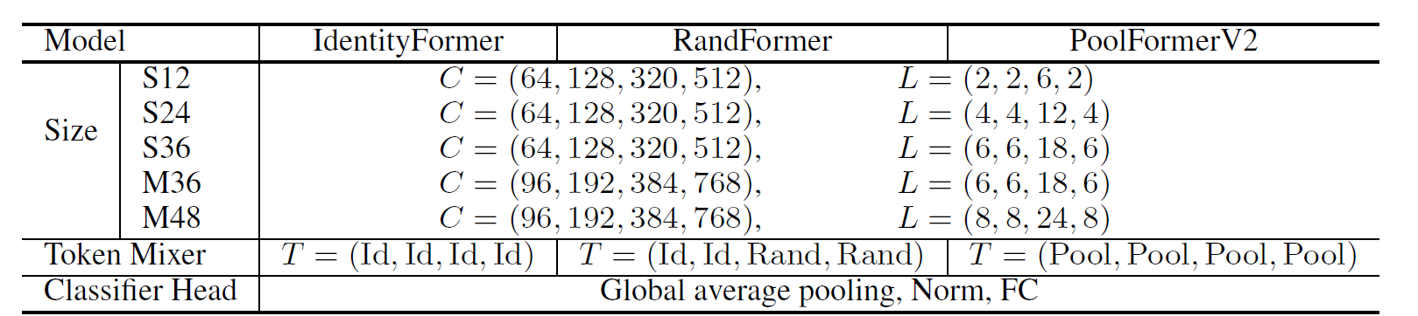
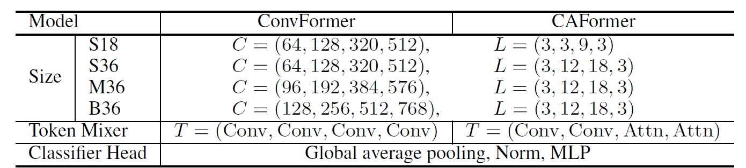
Model Configurations

Slide 13
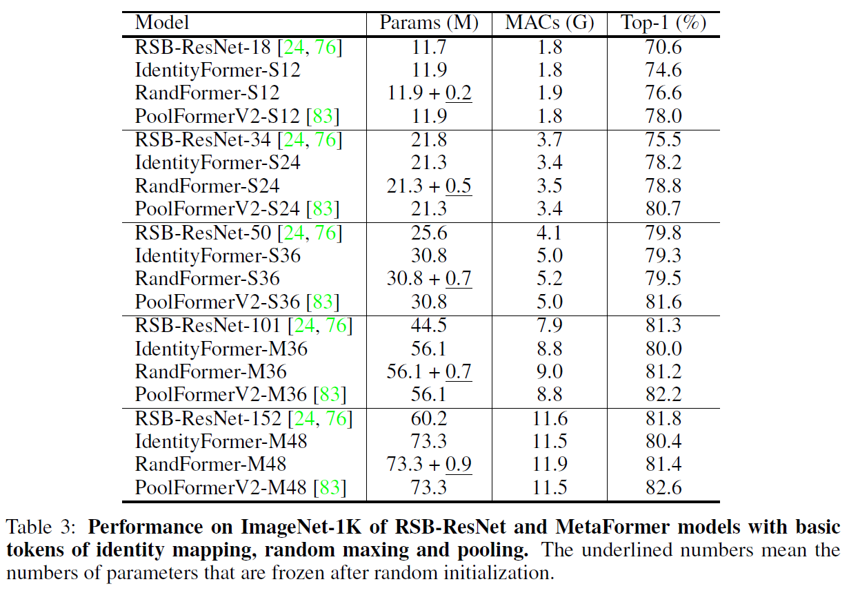
ImageNet Classification
IdentityFormer, RandFormer and PoolFormerV2
Notes:
Multiply–accumulate (MAC) or multiply-add (MAD) operation is a common step that computes the product of two numbers and adds that product to an accumulator.

Slide 14
ImageNet Classification
ConvFormer and CAFormer
Notes:
Multiply–accumulate (MAC) or multiply-add (MAD) operation is a common step that computes the product of two numbers and adds that product to an accumulator.

Slide 15
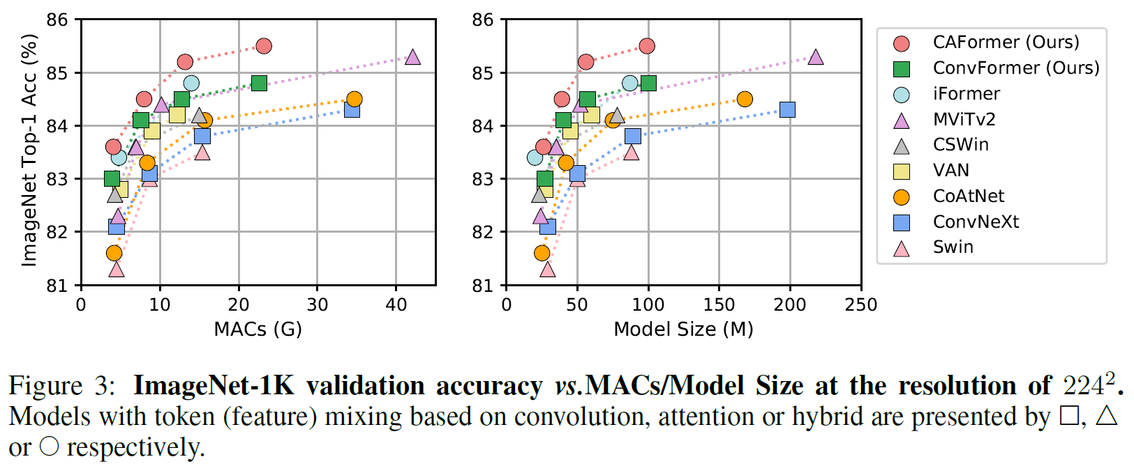
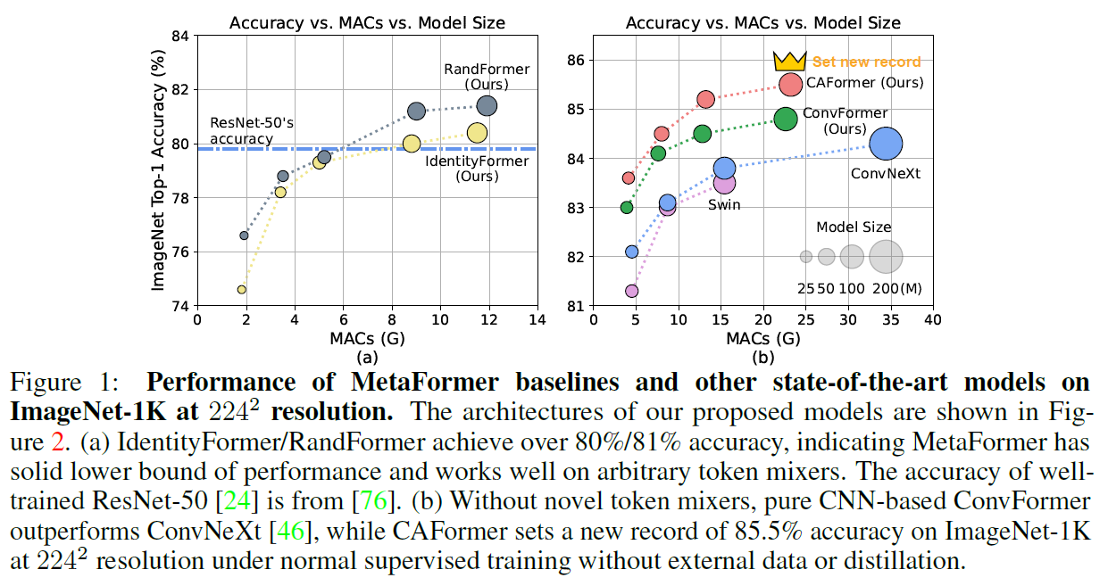
ImageNet Classification
ConvFormer and CAFormer
Notes:
Multiply–accumulate (MAC) or multiply-add (MAD) operation is a common step that computes the product of two numbers and adds that product to an accumulator.

Slide 16
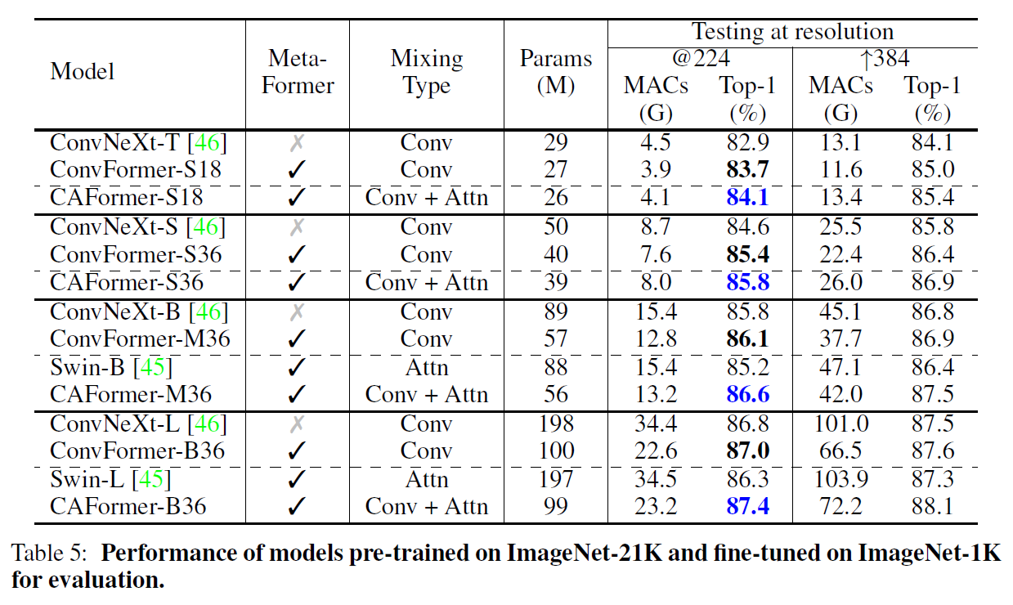
ImageNet Classification
ConvFormer and CAFormer
Notes:
Multiply–accumulate (MAC) or multiply-add (MAD) operation is a common step that computes the product of two numbers and adds that product to an accumulator.

Slide 17
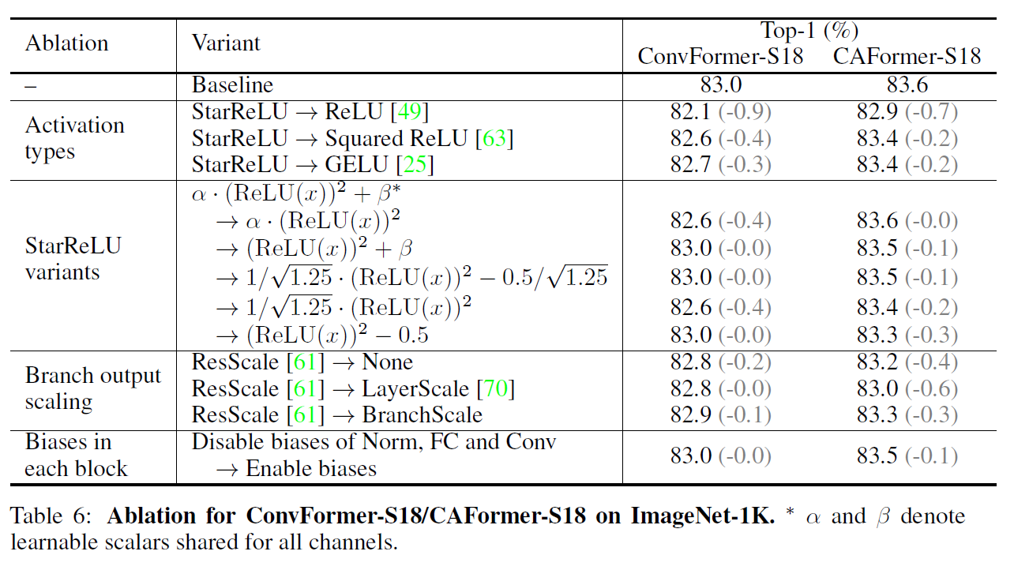
Ablation

Slide 18
Conclusion
MetaFormer works well with arbitrary token mixers.
IdentityFormer, RandFormer demonstrate solid lower bound of performance.
ConvFormer outperforms ConvNeXt.
CAFormer sets new record on ImageNet-1K at 224 resolution.
StarReLU, not only achieve better performance but also greatly reduces FLOPs of the activation function when compared with GELU.

Slide 19
Thank you for your attention

Slide 20
